Slide 1
Machine Learning Approach
- Genetic Algorithm -

Slide 2
1. Genetic Algorithm
1. Crossover
2. Mutation
3. Selection
* the shortest time

Slide 3
2. Analysis the Task
Find out the schedule which requires shortest time
Reflect task property of real space
Parallel
Dependency

Slide 4
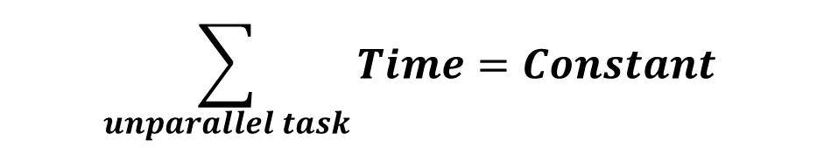
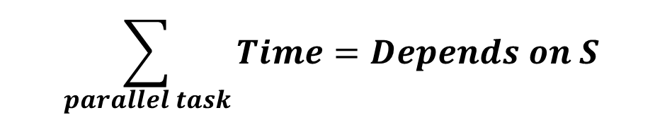

2. Analysis the Task
Parallel (X)
$$\sum_{unparallel task}{Time}=Constant$$
Parallel (O)
$$\sum_{parallel task}{Time}=Depends on S$$
$$∗S=Schedule$$

Slide 5
3. Data Structure
Schedule, SubSchedule, Task
SubSchedule 1
SubSchedule 2
SubSchedule 3
self.parallel = False
self.parallel = True
self.parallel = True
Task 1
Task 1
Task 1
Task N
Only one task
More than one task
More than one task

Slide 6
3. Data Structure
Schedule, SubSchedule, Task
SubSchedule 2
Class Task
- self.parallel
- self.predependency
- self.nxtdependency
- self.start
- self.finish = self.start + self.duration
- self.duration
self.parallel = True
Task 1
Task 3
Task 4
Task 2
start
(0)
finish
(t)
start
(t)
Regional Time (in SubSchedule)
*Real Time be calculated in the end

Slide 7
4. Schedule Rearrangement Pattern
Move unparallel task from SubSchedule to SubSchedule*
SubSchedule 1
SubSchedule 2
SubSchedule 3
self.parallel = False
self.parallel = True
self.parallel = True
Task 1
Task 1
Task 1
Task N
Task M
Task M
Rearrange (time)
considering dependency
Crossover

Slide 8
4. Schedule Rearrangement Pattern
Add new SubSchedule(parallel) between other SubSchedules(unparallel)
(=) same effect with moving the SubSchedule(unparallel)
SubSchedule 1
SubSchedule 2*
SubSchedule 3
SubSchedule 4
self.parallel = False
self.parallel = True
self.parallel = False
self.parallel = True
Task 1
Task 1
Task N
Task 1
Task N
Mutation

